Slide 1
SMART MATHEMATICS TUTOR USING IBM WATSON
CSE TEAM -10
TEAM MEMBERS:
19R11A0580
19R11A0582
19R11A0583
19R11A0585
20R15A0510

Slide 2
How to make Math Learning interactive to students without getting bored….??

Slide 3

SMART MATHEMATICS TUTOR USING IBM WATSON
Smart Math tutor system is a web based graphical user interface where a user gets to draw shapes of mathematical figures such as square, triangle, circle etc. for which the output would be related formulas to the drawn figure.
This project helps the students to learn math interactively and also make use of Interactive Technology in learning these things.

Slide 4
Steps for the Project:
Collection of data
Image Preprocessing
Model Building
Application Building
Train the Model on IBM

Slide 5

1. Collection of Dataset :
ML depends heavily on data, without data, it is impossible for a machine to learn. In this project, the dataset contains 3 classes – circle , square , triangle.
The data set used to train the model for performing various actions.
2. Image Preprocessing :
Import The Image Data Generator Library
Configure Image Data Generator Class
Apply Image Data Generator Functionality To Trainset And Test set

Slide 6
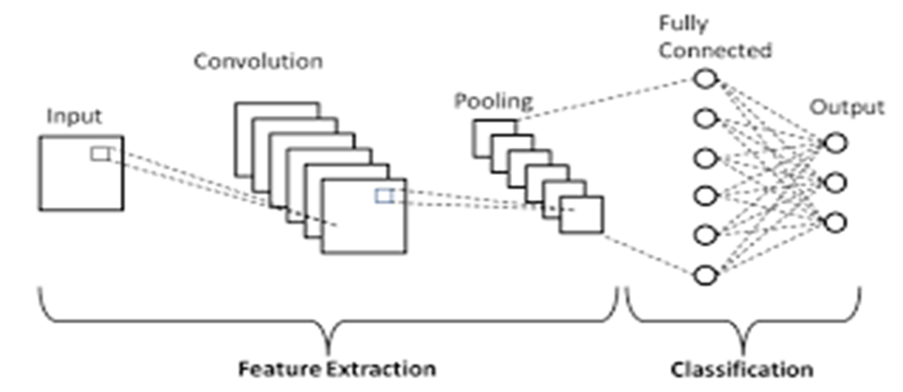
3. Model Building :
To build our Convolutional Neural Networking which contains an input layer along with the Convolution, Max Pooling and finally an output layer.
Importing The Model Building Libraries
Initializing The Model
Adding CNN Layers
Adding Dense Layers
Configure The Learning Process
Train The Model
Save The Model
Test the Model

Slide 7
4. Application Building:
After the Model trained , we will be building a flask application which will be running in our local browser with a UI.
In this Application building process,
First ,we use HTML pages to create front end part of web pages;
Then ,building FLASK file which is a web framework written in python for server-side scripting
Importing Libraries -> Creating our flask application -> Routing to the different html pages -> Creating a GUI -> Grabbing the image and sending it to our model for prediction -> Showcase the results with the help of open cv .
And then run the application.
5. Train the Model on IBM :
In this step we deploy our model in IBM and integrate it with the flask application.

Slide 8
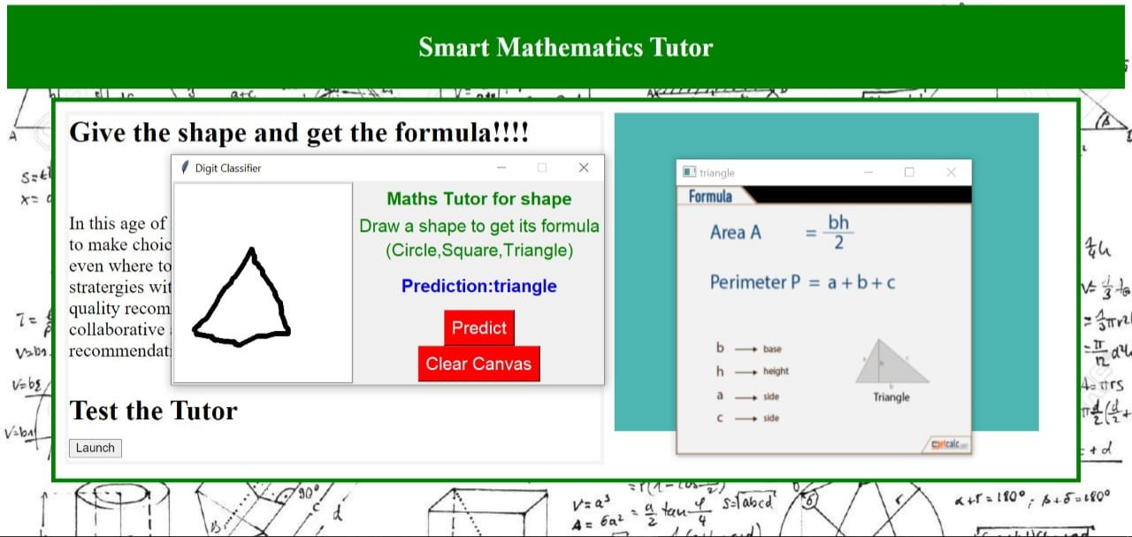
FINAL OUTPUT :

Slide 9
THANK YOU…!!

